Slide 1

Movies At a Glance
Ankith Goutham
Avinash PAMULA
amanda stead
Aarti pandya
Taraque ahmed

Slide 2
Intro
Microservices that displays 5 movies
Allows user to book tickets online
Pay for the tickets
Watch the trailers
Find location
View seating
Provided with receipt
Handing off to Amanda

Slide 3
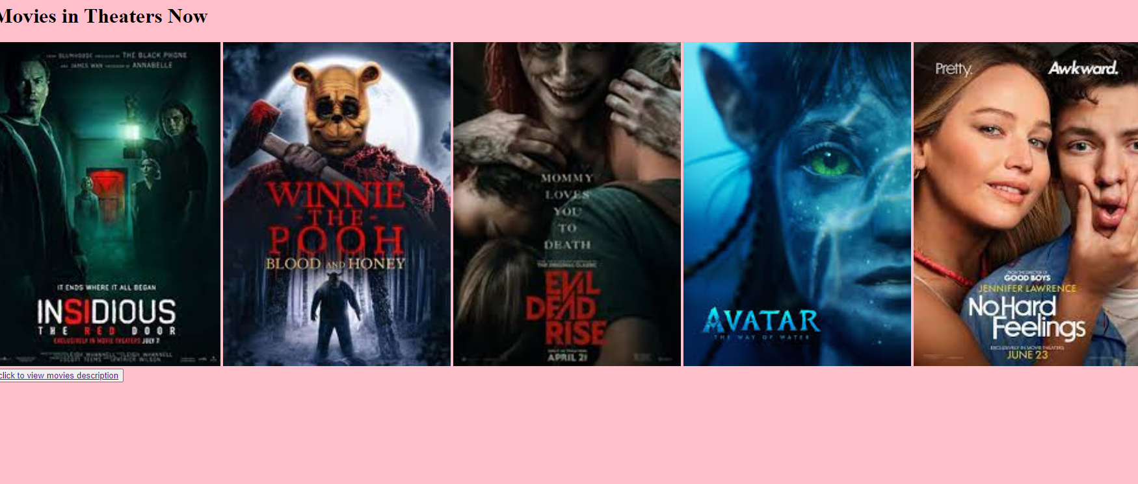
Display Movies
This microservice displays 5 movies
Returns in HTML
Routes to another flask app (Descriptions)
Handing off Avinash

Slide 4
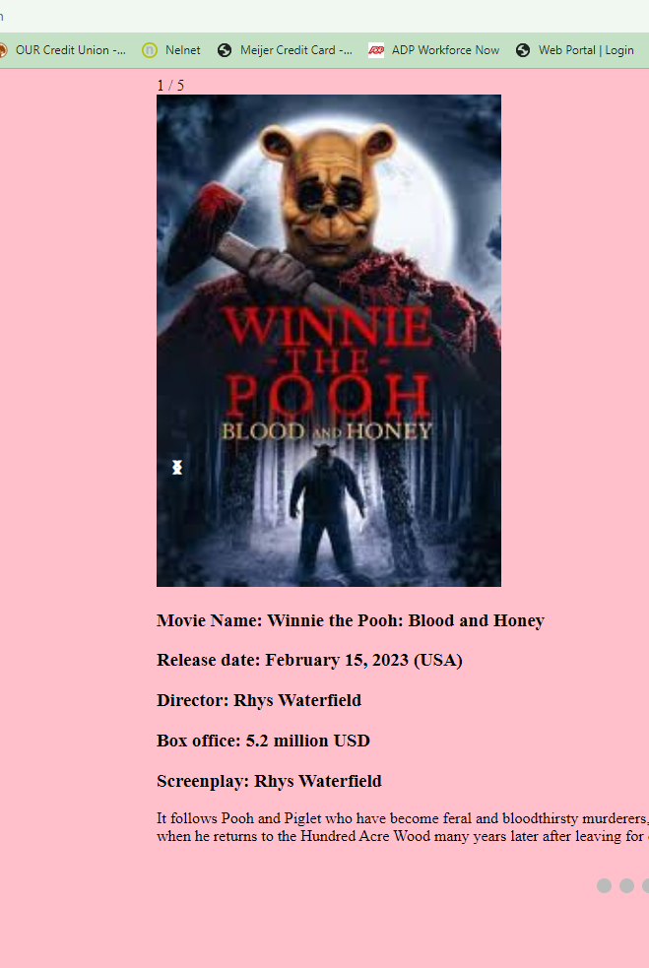
Movie Description
Display single movie description at a time
You can look for other movie descriptions by clicking on below dots.
UI displayed is written with HTML,CSS,JS
The description file is routed from movie displays and then routed to seat selection using flask app

Slide 5
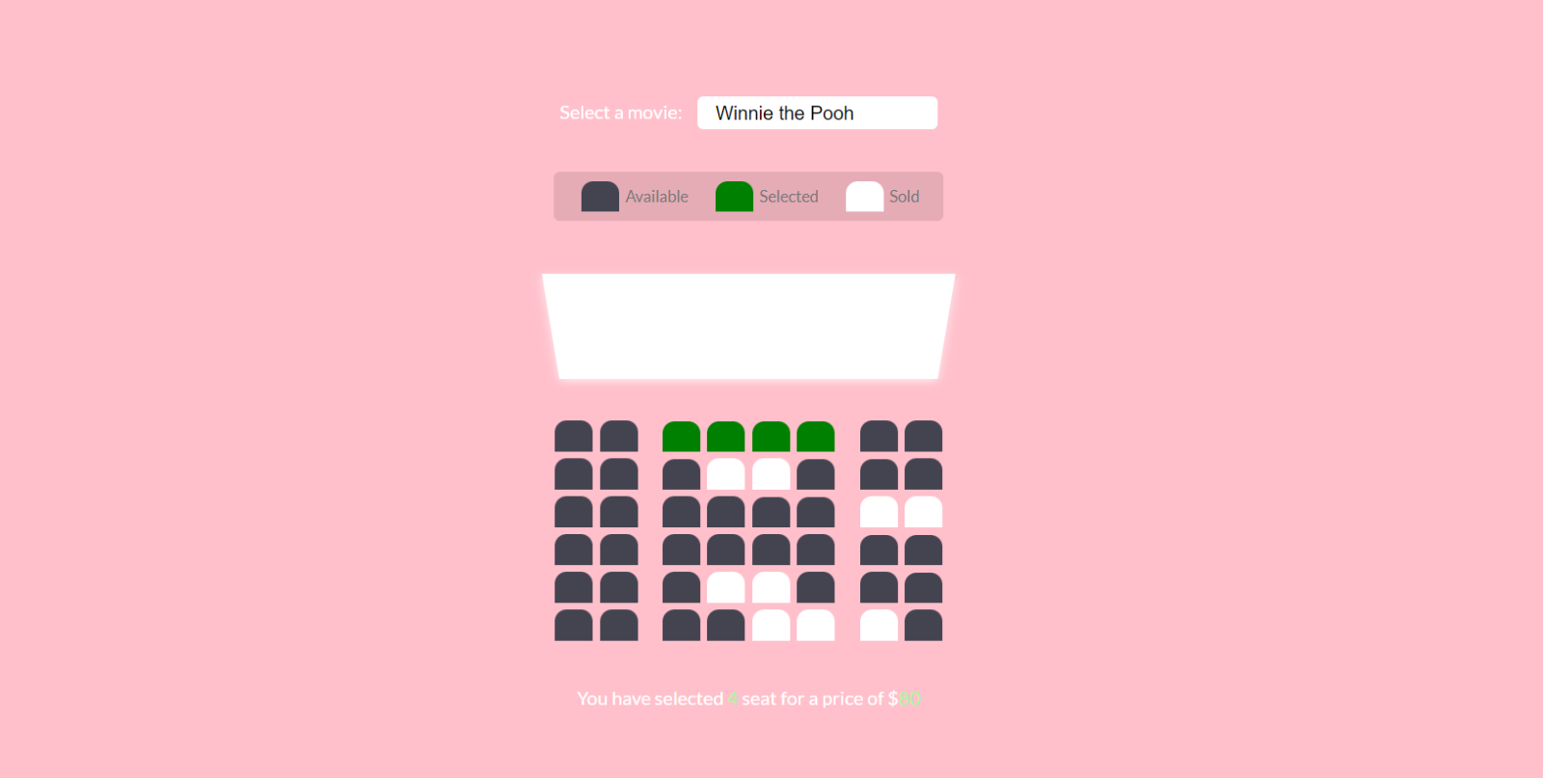
Seat Selection
Page displays seat selection option for selected movie from drop down along with ticket prices.
UI is based on HTML,CSS,JS
Allows user to select seats and shows occupied, available & selected seats.
The seat selection file in routed in flask app
Handing off to Taraque

Slide 6
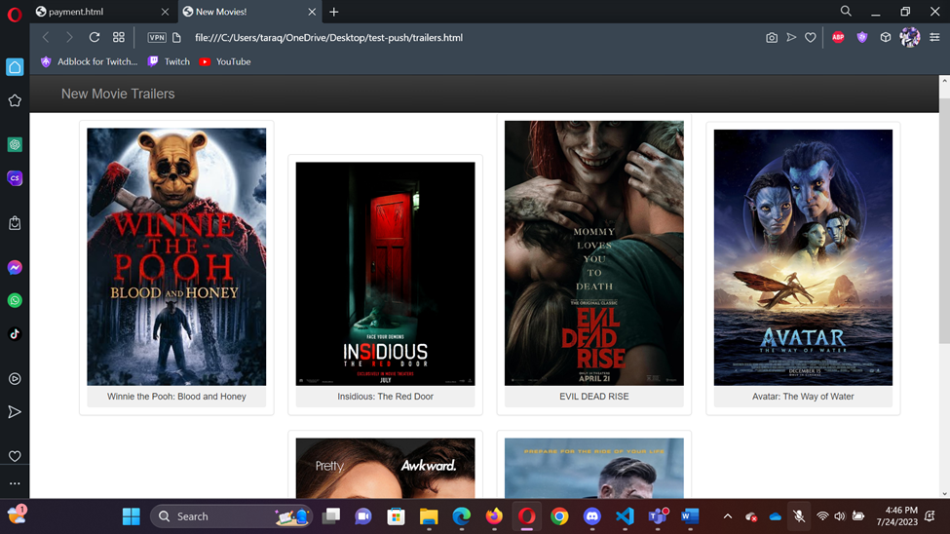
Trailer
Show's list of new movies.
Click any movie in this list to watch trailer.
You can watch trailer one by one.
After you finish watching trailer pick whatever movie you want to watch.
Handing off to Aarti

Slide 7
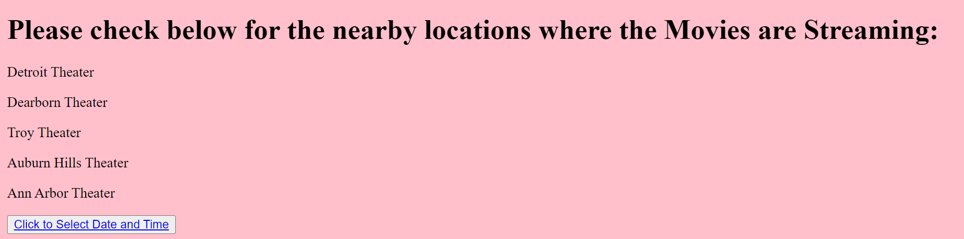
Locations
Shows the available locations where the movies are streaming.
User can check their nearby theaters and proceed to select Date and Time.
UI displayed is written with HTML,CSS,JS and routed using flask app.
Handing off to Ankith

Slide 8
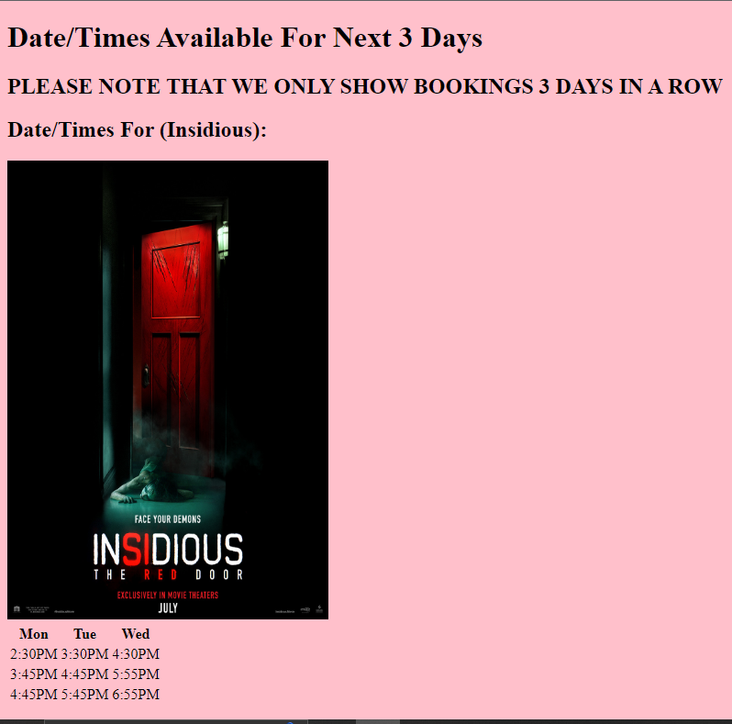
Date/Time - Ankith
Shows movies independently
Shows viewings for the next 3 days
Same movies in other slides to maintain consistency
Leads into snacks.
Handing off to Taraque

Slide 9
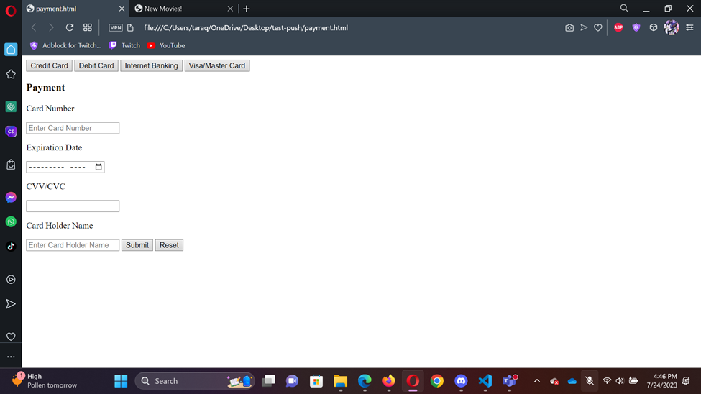
Payment
Credit card
Debit Card
Internet Banking
Visa/Master card
Pick any off this to pay you bill
Handing off to Aarti

Slide 10
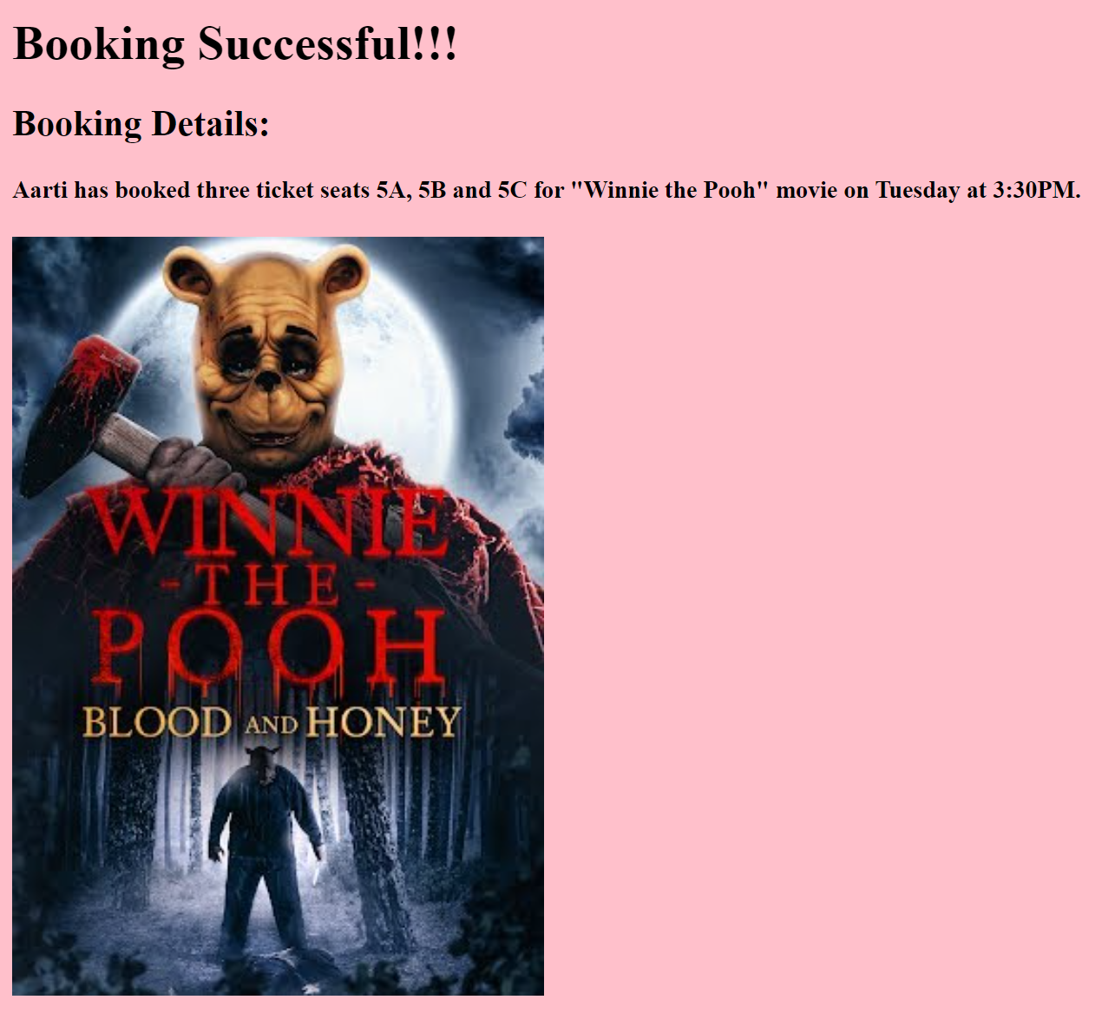
Booking
Displays the booking details of the user.
Shows name of the user, number of tickets, seat number, movie name, day and time of the movie along with the poster of the movie.
Leads to receipt microservice.
Handing off to Ankith

Slide 11
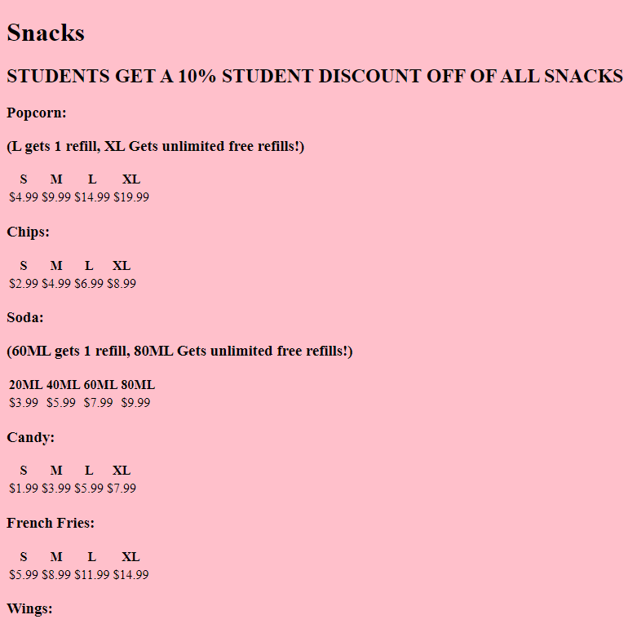
Snacks
Shows a variety of options for snacks
Different sizes are given, alongside prices
Different deals are offered for some items
Student discount is 10% sitewide for snacks
Handing off to Amanda

Slide 12

Receipt
Submitted to client after purchase
Returns HTML
Routes from payment microservice

Slide 13

Resources and Tools
Agile methodology: Jira
Docker Hub to containerize
Kubernetes
Flask App
HTML
CSS
Java script
Python
Git hub
Py charm & VS code

Slide 14
Demo

